Slide 1
FUNDAMNETALS OF SOFTWARE PROJECT MANAGEMENT
Resource Allocation
Week-11

Slide 2
Objectives
Nature of Resources
Identifying Resource Requirements
Scheduling Resources
Resource Scheduling Techniques

Slide 3
Schedules
Activity schedule - indicating start and completion dates for each activity
Resource schedule - indicating dates when resources needed + level of resources
Cost schedule showing accumulative expenditure

Slide 4
Nature of Resources
These include
  labour
  equipment (e.g. workstations)
  materials
  space
  services
Time: elapsed time can often be reduced by adding more staff
Money: used to buy the other resources
Notes:
Section 8.2 in the main text discusses this in a little more detail.
A key point is that money (by definition) is the means by which one resource can be converted to another. However in practice this may be problematic because of resource constraints e.g. staff need time to become expert in a new technology regardless of the amount of money that might be available to buy expertise.

Slide 5
Identifying Resource Requirements
The first step in producing a resource allocation plan is to list the resources.
  Activity Specific Resources
  Resources not specific to activity
    Project Manager (Part of Project Infrastructure)
    Office Space
Notes:
Activity-Specific Resources:
Labor/Personnel:
Identify the specific roles needed for each activity (e.g., developers, designers, testers).
Estimate the number of hours or FTE (Full-Time Equivalents) required for each role.
Equipment/Tools:
List any specialized tools or equipment needed for certain activities (e.g., software licenses, hardware).
Consider whether any equipment needs to be rented or purchased.
Materials/Supplies:
Identify any materials or supplies needed for specific tasks (e.g., raw materials for manufacturing, office supplies).
Training:
Determine if any training or certifications are necessary for team members to complete certain activities effectively.
Resources Not Specific to Activity:
Project Manager:
Allocate time or FTE for the project manager's involvement.
Consider if additional project management support is required.
Office Space:
Determine the physical space requirements for the project team.
Consider any specific needs such as meeting rooms, quiet spaces, or collaboration areas.
Infrastructure:
Include any necessary IT infrastructure, such as servers, networking equipment, or cloud services.
Consider communication tools, project management software licenses, etc.
Budget:
Estimate the overall project budget required to support resource needs.
Include costs for salaries, equipment, materials, training, and any other expenses.
Time:
Determine the project timeline and schedule resources accordingly.
Consider any dependencies between activities and allocate resources accordingly.
Risk Management:
Identify potential risks that could impact resource availability (e.g., staff turnover, equipment failure) and develop mitigation strategies.
Quality Assurance:
Allocate resources for quality assurance activities to ensure project deliverables meet quality standards.

Slide 6
Resource allocation
Identify the resources needed for each activity
Identify resource types - individuals are interchangeable within the group (e.g. ‘VB programmers’ as opposed to ‘software developers’)
Allocate resource types to activities and examine the resource histogram.
Notes:
Step 1: Identify Activities and Resource Types
Activity 1: Software Development
Resource Types: VB Programmers, UI/UX Designers, Quality Assurance Testers
Step 2: Allocate Resource Types to Activities
Activity 1: Software Development
VB Programmers: 3
UI/UX Designers: 2
Quality Assurance Testers: 2
Step 3: Examine the Resource Histogram
A resource histogram visually represents the allocation of resources over time.

Slide 7
Resource histogram: systems analysts
5
4
STAFF REQD.
3
2
1
1
2
3
4
5
6
7
WEEK
Notes:
The resource histogram helps us identify where the demand for a resource exceeds the supply.
If we use a tool such as MS Project, the tool will generate the resource histograms for us.

Slide 8
Resource clashes
can be resolved by:
  delaying one of the activities
    taking advantage of float to change start date
    delaying start of one activity until finish of the other activity that resource is being used on - puts back project completion
  moving resource from a non-critical activity
  bringing in additional resource - increases costs
Notes:
Exercise 8.1 in the text gives some practice in the resolution of resource clashes.
critical activities are those that are essential for completing the project on time, while non-critical activities are less time-sensitive and can be delayed without impacting the overall project schedule.

Slide 9
Resource optimization
Resource leveling. A technique in which start and ﬁnish dates are adjusted based on resource constraints with the goal of balancing the demand for resources with the available supply.
It can be used when
    shared or critically required resources are available only at certain times or in limited quantities,
    Resources are over- allocated,
    there is a need to keep resource usage at a constant level.
Resource leveling can often cause the original critical path to change.
Available ﬂoat is used for leveling resources. Consequently, the critical path through the project schedule may change.
Notes:
You use resource leveling when you have limited resources and you may extend the schedule.
Let’s say you are developing a schedule for a project, which is to construct a two-story building. To construct the first floor you have enough scaffolding but for the second floor, you need extra scaffolding.
So you look within your organization and find that you can arrange extra scaffolding from another project, but one week later than what you require.
So, you delay construction activities on the second floor by one week.
This is an example of resource leveling where you extend the schedule to get the resource.

Slide 10
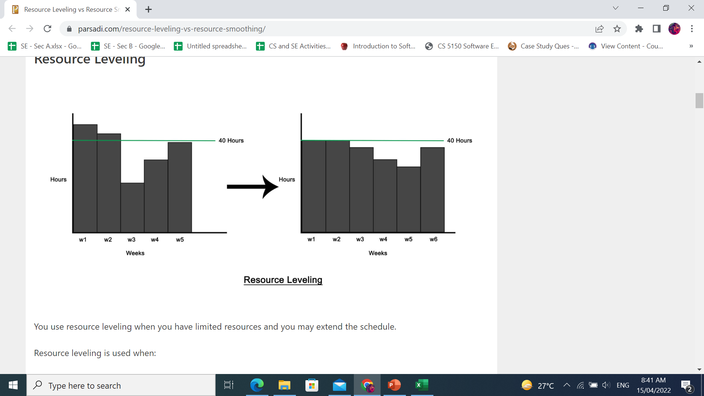
Resource optimization

Slide 11
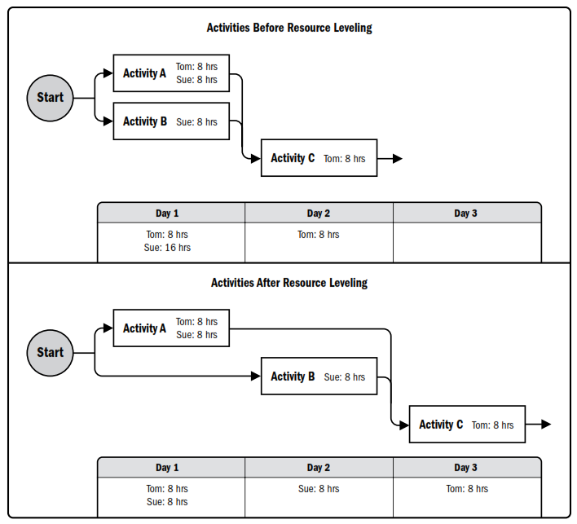

Slide 12
Resource optimization
Resource smoothing. A technique that adjusts the activities of a schedule model such that the requirements for resources on the project do not exceed certain predeﬁned resource limits.
In resource smoothing, as opposed to resource leveling, the project’s critical path is not change and the completion date may not be delayed.
In other words, activities may only be delayed within their free and total ﬂoat.
Resource smoothing may not be able to optimize all resources.

Slide 13
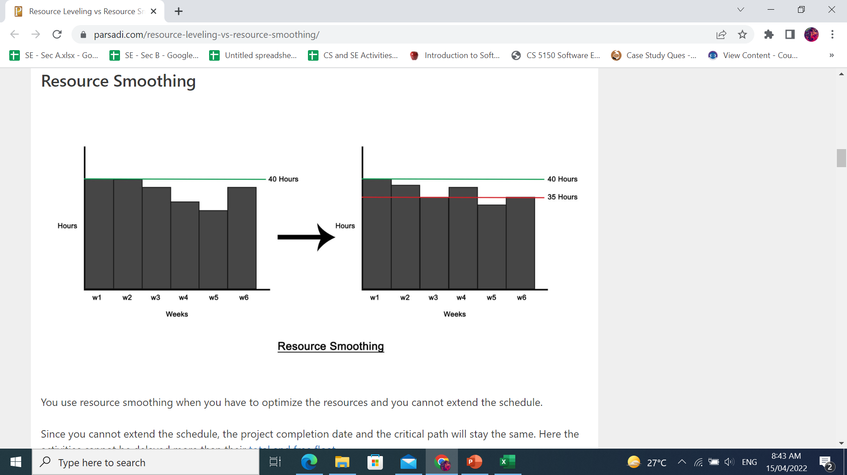
Resource optimization
Notes:
Resource smoothing is used when the time constraint takes priority.

Slide 14

Prioritizing activities
There are two main ways of doing this:
Total float priority – those with the smallest float have the highest priority
Ordered list priority – this takes account of the duration of the activity as well as the float
Notes:
Both approaches have their merits and may be suitable depending on the specific requirements and constraints of the project. Total float priority focuses solely on the flexibility of activity schedules, while ordered list priority takes into account both duration and float to provide a more comprehensive prioritization strategy. Project managers should evaluate the characteristics of their project and choose the approach that best aligns with their goals and objectives.

Slide 15
Prioritizing activities
Where more than one activity is competing for the same limited resource at the same time then those activities need to be prioritized.
Burman’s priority list
Give priority to:
Shortest critical activities
Other critical activities
Shortest non-critical activities
Non-critical activities with least float
Non-critical activities

Slide 16
Critical path
Scheduling resources can create new dependencies between activities –
It is best not to add dependencies to the activity network to reflect resource constraints
  Makes network very messy
  A resource constraint may disappear during the project, but link remains on network
Amend dates on schedule to reflect resource constraints
Notes:
In Lecture/chapter 7 the concept of critical chains was introduced which took account of resource constraints.
The point about not adding links to the network to deal with resource constraints is not in the text, but is based on practical experience. The notation for activity networks does not tell you why one activity might be dependent on the completion of another.

Slide 17
Allocating individuals to activities
The initial ‘resource types’ for a task have to be replaced by actual individuals.
Factors to be considered:
Availability
Criticality
Risk
Training
Team building – and motivation
Notes:
Availability – who is free? Note that this will change during the course of the project as some tasks are completed earlier or later than planned
Criticality – You would want to put your more experienced, ‘safer’, staff on the critical activities
Risk – this is similar to the point above, but some activities could be off the critical path but still have risks e.g. to the quality of subsequent products
Training – despite concerns about minimizing risk, it is healthy to take some risks in order to develop staff capabilities by allocating challenging tasks to relatively inexperienced stafff
Team-building – identifying people who work well together can pay dividends; chopping and changing plans all the time may in theory optimize project performance, but can in practice be demotivating for staff

Slide 18
Cost schedules
Cost schedules can now be produced:
Costs include:
Staff costs
Overheads
Usage charges
Notes:
Section 8.9 covers this in more depth.
Staff costs – includes not just salary, but also social security contributions by the employer, holiday pay etc. Timesheets are often used to record actual hours spent on each project by an individual. One issue can be how time when a staff member is allocated and available to the project, but is not actually working on the project, is dealt with.
Overheads e.g. space rental, service charges etc. Some overheads might be directly attributable to the project; in other cases a percentage of departmental overheads may be allocated to project costs.
Usage charges – some charges can be on a ‘pay as you go’ basis e.g. telephone charges, postage, car mileage – at the planning stage an estimate of these may have to be made

Slide 19
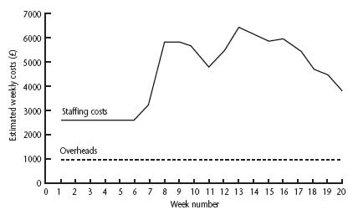
Cost profile
Notes:
This shows how much is going to be spent in each week. This could be important where an organization allocates project budgets by financial year or quarter and the project straddles more than one of these financial periods

Slide 20
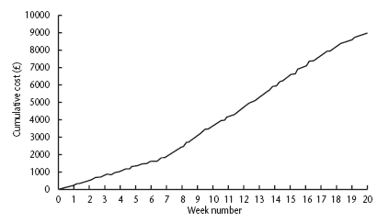
Accumulative costs
Notes:
The project manager will also be concerned about planned accumulative costs. This chart can be compared to the actual accumulative costs when controlling the project to assess whether the project is likely to meet its cost targets.

Slide 21
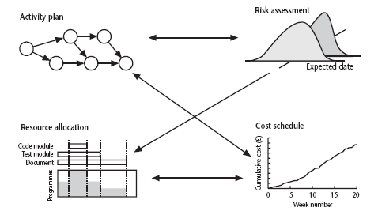
Balancing concerns
Notes:
Successful project scheduling is not a simple sequence.
Because of the inter-linking of different concerns project planning will need to be iterative. The consequences of decisions will need to carefully assessed and plans adjusted accordingly.

